Slide 1
British Airways
Predicting customer buying behaviour

Slide 2
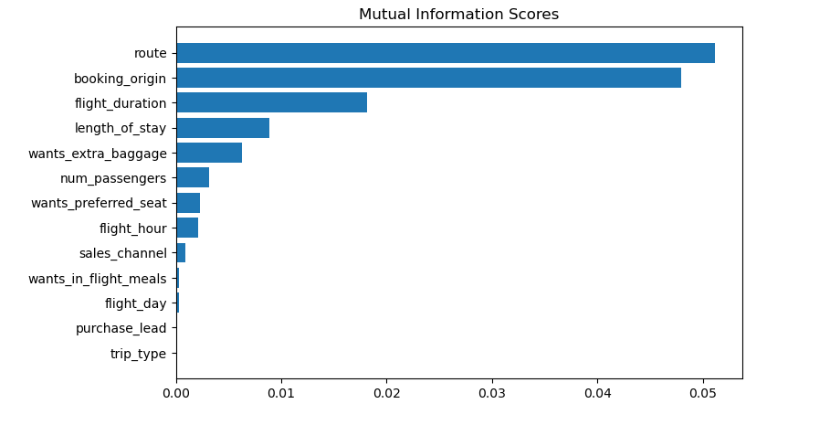
RandomForest Model Classifier
Trained and tested the model on the provided dataset using the Random Forest Classifier, and got the following acceptable results:
ACCURACY: 80.08
AUC score: 0.5015
Features which include; route, booking_origin, flight_duration, length_of_day, extra_baggage, num_passengers had the highest mutual scores indicating that they are statistically significant in predicting customer bookings.
The business is advised to take more attention to these variables of the customer journey, and tailor make initiatives that propel customers to complete a booking, such as offering ticket discounts or continuous improvement of flight routes.

